Slide 1
Day 1 - HTML DOM
Authored by : Pooja Jain Presented by : Pooja Jain

Slide 2
Document History
Version No. | Authored/ Modified by | Remarks/ Change History | Date <dd- mon-yy >
1.0 | Pooja Jain |  | 20-09-2016

Slide 3
Learning Objectives
Quick JS Revision
HTML-DOM
What is DOM
Core Interfaces in the DOM
Programs

Slide 4
Course Structure
Target audience | Fresher
Level | 1
Pre-requisites | HTML, CSS and Javascript
Training methods | PPT and Programs
Evaluation | Assignments provided

Slide 5
Quick JS Revision
What is JS used for?
How do we execute JS?
What are different types of variables?
What are the different mouse, keyboard, focus, load, resize, change and submit events?
What are the different JS Objects?

Slide 6
HTML DOM
To understand how JavaScript interacts with websites, we first have to know about the Document Object Model (DOM).
The DOM is a representational structure of HTML documents.
It is a standard for how to get, change, add, or delete HTML elements.

Slide 7
DOM Nodes
The DOM says:
The entire document is a document node.
Every HTML element is an element node.
The text in the HTML elements are text nodes.
Every HTML attribute is an attribute node.
Comments are comment nodes.
So the entire html page can be considered as a tree-like structure.
And so you’ll have parent, children and sibling relationships.

Slide 8
Sample HTML page
<!doctype html>
<html>
<head>
<title>My home page</title>
</head>
<body>
<h1>My home page</h1>
<p>Hello, I am Marijn and this is my home page.</p>
<p>I also wrote a book! Read it
<a href="http://eloquentjavascript.net">here</a>.
</p>
</body>
</html>

Slide 9
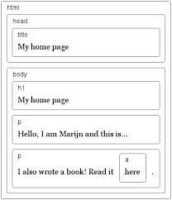
Document Object Model

Slide 10
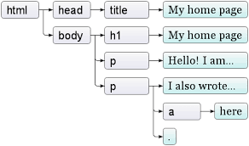
Document Tree
The leaves are text nodes, and the arrows indicate parent-child relationships between nodes.

Slide 11
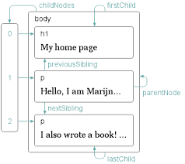
Moving through the tree

Slide 12
How Do I Access the DOM structure with JS?
You don't have to do anything special to begin using the DOM.
When you create a <script> you can immediately begin the manipulation of the document itself.
DOM programming which displays an alert message by using the alert() function from the window object
<body onload=“document.body.innerHTML(‘Hello Pooja’);">
Hello World!
</body>
NOTE: Although the above code works fine, we should be using addEventListener() method to bind the events. (more on this later..)

Slide 13
Core Interfaces in the DOM - Accessing Elements
Nodes can be accessed in different ways:
getElementById()- Returns a reference to the element with the specified ID
var testdiv = document.getElementById(“mydiv”);
getElementsByName()- Returns all references to elements with specified name
var testdivs = document.getElementsByName(“myname”);

Slide 14
Core Interfaces in the DOM - Accessing Elements
getElementsByTagName() - Returns all references to all elements with a specified tag name.
var container = document.getElementById(“mydiv”);
var testdivs = container.getElementsByTagName(“div”);
getElementsByClassName() - Returns all references to elements having specified class name.
var container = document.getElementById(“mydiv”);
var testdivs = container.getElementsByClassName(‘myclass’);

Slide 15
Core Interfaces in the DOM - Changing Elements
Changing text
Changing attributes
Changing appearance
Refer 1_program.html

Slide 16
Core Interfaces in the DOM - Adding and removing elements
To create an element:
var mydiv = document.createElement(“div”);
To add an element to the document:
document.body.appendChild(mydiv);
To remove and element from the document:
document.body.removeChild(mydiv);
Refer 2_program.html

Slide 17
Core Interfaces in the DOM – Adding event listeners
Registers the specified listener on the EventTarget.
target.addEventListener(type, listener);
target - an Element in a document, the Document itself, a Window, or any other object that supports events.
type - A string representing the event type to listen for.
listener - The object that receives a notification when an event.
document.addEventListener(‘click’, function () {
alert('Click on document');
});

Slide 18
Lets try to access document elements
// dom.html
// Do the following using core Interfaces in the DOM
Pick up all the div elements.
Pick up the element having id “myelement”.
Pick up the div having id “testid”.
Pick up all the elements with class “content”.
Create a span element and append inside element having id "spanparent"
Add click listener to document.

Slide 19
Lets write useful code now
// sampledom.html
Create the usual form with various form elements, and add in validation.
Segregate JS and CSS in separate .js and .css files and include them in sampledom.html

Slide 20
References
https://developer.mozilla.org/en-US/docs/Web/API/Document_Object_Model/Introduction
http://eloquentjavascript.net/13_dom.html

Slide 21
Any Questions?

Slide 22
Thank You!

